Slide 1
The particle method for simulation of self-organization phenomena
Rafał Sienkiewicz
Gdansk University of Technology, Gdańsk, Poland

Slide 2
The DigiHive environment
Main features, physics, programs…

Slide 3
Basic features
An abstract environment designed for artificial life simulations
2 dimensional lattice with periodic boundary conditions
Large number of entities called particles
Particles can bond together forming a complex of particles
At a higher level, the complexes of particles may be interpreted as a program

Slide 4
Physics

Slide 5
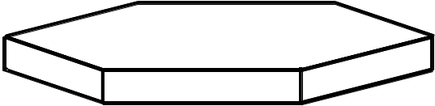
Physics - particles
Particles are of 256 types, each particle is related to a set of attributes (e.g. mass)
Particles are marked with velocity and position
Moving and colliding according to simplified Newtonian mechanics (conservation of energy and momentum)
Either elastic or inelastic collisions

Slide 6

Collissions

Slide 7
Physics - complexes
Two or more particles form a complex of particles.
Each particle can bind both horizontally (6 directions) and vertically with other particles

Slide 8
Physics - complexes
Two or more particles form a complex of particles.
Each particle can bind both horizontally (6 directions) and vertically with other particles

Slide 9
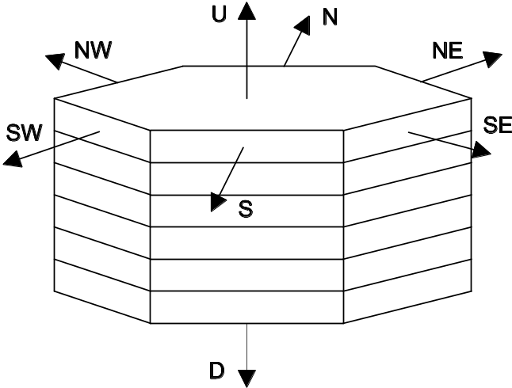
Physics - complexes
Two or more particles form a complex of particles.
Each particle can bind both horizontally (6 directions) and vertically with other particles

Slide 10
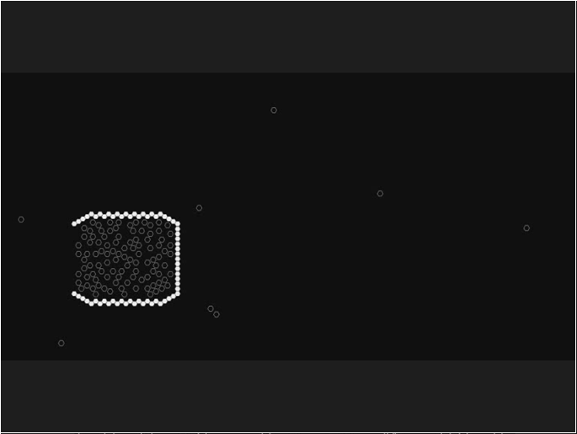
Example – jet propulsion engine
Complex of particles
Particles

Slide 11
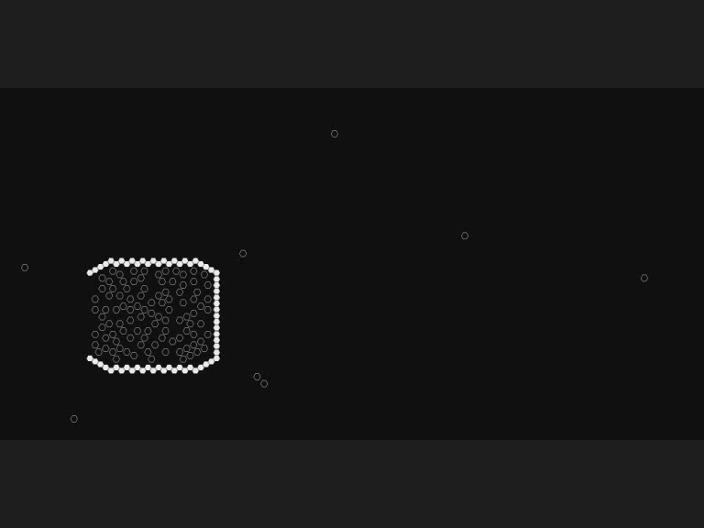
Example – jet propulsion engine

Slide 12
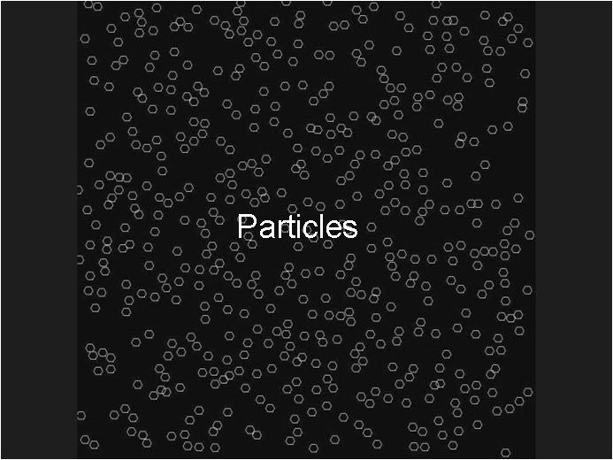
Example – random structures

Slide 13
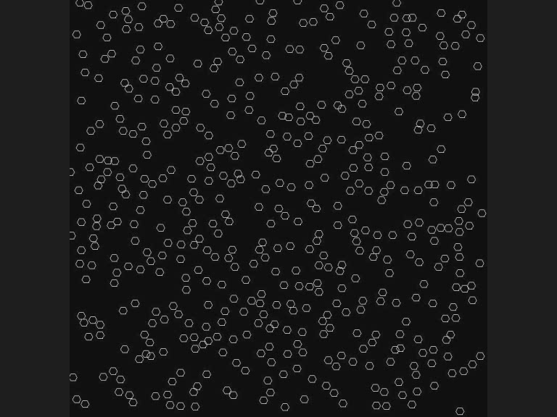
Example – random structures

Slide 14
Programs

Slide 15
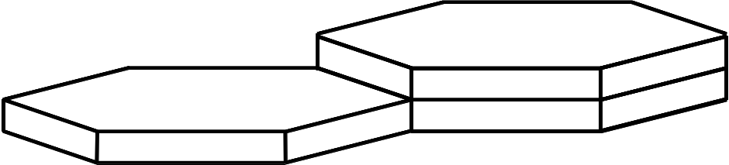
Programs
The structure of a complex is interpreted as a program written in a declarative language (simplified Prolog)

Slide 16
Programs
A program is able to selectively create and remove bonds between particles in its neighbourhood
Stage1: searching - asking about the type of particle and state of its walls (is it bound, is it adjacent)
  Possibility of checking an optional condition of nonexistence of a particular complex or particles (reaction inhibitor)
Stage 2: acting - creating and removing bonds between found particles

Slide 17
Programs
Declarative language provides ”softness” – small changes in program code should result in small changes in program activity
No high level search and action instructions
There are no global rules governing the programs (e.g. no fitness function specified)

Slide 18
Program example
program():– search(), action().
search():– structure(0).
structure(0):–
exists([0,0,0,0,0,0,×,×], mark V1),
exists([1,1,1,1,1,1,1,1] bound to V1 in N, mark V2),
exists([0,0,0,0,0,0,0,0], mark V5),
not(structure(1)),
not(structure(2)).
structure(1):–
exists([1,1,1,1,0,0,0,0] bound to V2 in NW, mark V3),
exists([1,1,1,1,0,0,0,0] bound to V3 in SW, mark V4),
not(structure(3)).
structure(3):–
exists([0,0,0,0,1,1,1,1] bound to V4 in S).
structure(2):–
exists([1,0,1,0,1,0,1,0]).
action():–
bind(V2 to V5 in SW)

Slide 19
Program commands
Structure maintaing: program, action, search, structure, not
Searching: exists [type/not type] [bound/not-bound/adjacent] [in dir] [to vx], mark v
  Ask about: type, state of walls, relation to previously found particle
  No information about position and velocity
  Backtracing
Action: bind, unbind, move
  Imperative

Slide 20
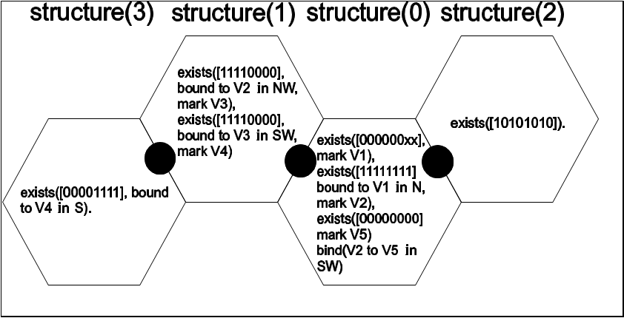
Program example

Slide 21
Encoding stack
…
Pointer 1 and 2 (1 byte)
Specification
Action (1,1,0,0,×,×,×,×)
…
Direction
Pointers (2) – 1 byte
Type mask
Type
Specification
Exists (0,0,1,1,×,×,×,×)
…
Program (1,1,1,1,×,×,×,×)
…

Slide 22
Encoding - specification
Exists
Action
0 – not type 1 - type | 00 - not bound 01 – adjacent 10 - bound | 10 – to | 11 - in | 1 – mark
1 bit | 2 bits | 2 bits | 2 bits | 1 bit
Unused | 00 - bind 10 - move 01 – unbind | 1 – to | 1 - in
4 bits | 2 bits | 1 bit | 1 bit

Slide 23
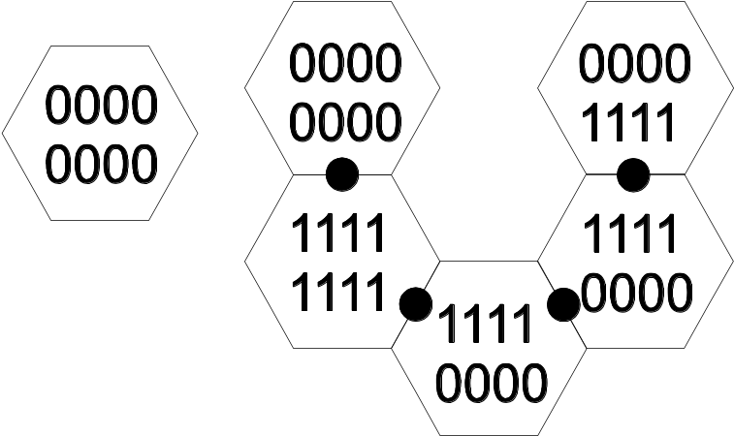
Program example
program():– search(), action().
search():– structure(0).
structure(0):–
exists([0,0,0,0,0,0,×,×], mark V1),
exists([1,1,1,1,1,1,1,1]
bound to V1 in N, mark V2),
exists([0,0,0,0,0,0,0,0], mark V5),
not(structure(1)),
not(structure(2)).
structure(1):–
exists([1,1,1,1,0,0,0,0]
bound to V2 in NW, mark V3),
exists([1,1,1,1,0,0,0,0]
bound to V3 in SW, mark V4),
not(structure(3)).
structure(3):–
exists([0,0,0,0,1,1,1,1] bound to V4 in S).
structure(2):–
exists([1,0,1,0,1,0,1,0]).
action():–
bind(V2 to V5 in SW)

Slide 24
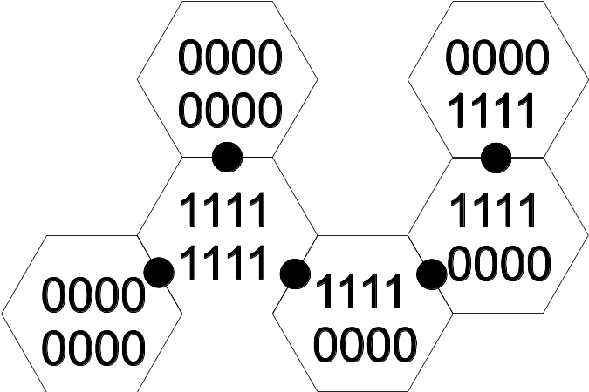
Program example
program():– search(), action().
search():– structure(0).
structure(0):–
exists([0,0,0,0,0,0,×,×], mark V1),
exists([1,1,1,1,1,1,1,1]
bound to V1 in N, mark V2),
exists([0,0,0,0,0,0,0,0], mark V5),
not(structure(1)),
not(structure(2)).
structure(1):–
exists([1,1,1,1,0,0,0,0]
bound to V2 in NW, mark V3),
exists([1,1,1,1,0,0,0,0]
bound to V3 in SW, mark V4),
not(structure(3)).
structure(3):–
exists([0,0,0,0,1,1,1,1] bound to V4 in S).
structure(2):–
exists([1,0,1,0,1,0,1,0]).
action():–
bind(V2 to V5 in SW)

Slide 25
Program example
program():– search(), action().
search():– structure(0).
structure(0):–
exists([0,0,0,0,0,0,×,×], mark V1),
exists([1,1,1,1,1,1,1,1]
bound to V1 in N, mark V2),
exists([0,0,0,0,0,0,0,0], mark V5),
not(structure(1)),
not(structure(2)).
structure(1):–
exists([1,1,1,1,0,0,0,0]
bound to V2 in NW, mark V3),
exists([1,1,1,1,0,0,0,0]
bound to V3 in SW, mark V4),
not(structure(3)).
structure(3):–
exists([0,0,0,0,1,1,1,1] bound to V4 in S).
structure(2):–
exists([1,0,1,0,1,0,1,0]).
action():–
bind(V2 to V5 in SW)

Slide 26
Program example
program():– search(), action().
search():– structure(0).
structure(0):–
exists([0,0,0,0,0,0,×,×], mark V1),
exists([1,1,1,1,1,1,1,1]
bound to V1 in N, mark V2),
exists([0,0,0,0,0,0,0,0], mark V5),
not(structure(1)),
not(structure(2)).
structure(1):–
exists([1,1,1,1,0,0,0,0]
bound to V2 on NW, mark V3),
exists([1,1,1,1,0,0,0,0]
bound to V3 on SW, mark V4),
not(structure(3)).
structure(3):–
exists([0,0,0,0,1,1,1,1] bound to V4 in S).
structure(2):–
exists([1,0,1,0,1,0,1,0]).
action():–
bind(V2 to V5 in SW)

Slide 27
Program example
program():– search(), action().
search():– structure(0).
structure(0):–
exists([0,0,0,0,0,0,×,×], mark V1),
exists([1,1,1,1,1,1,1,1]
bound to V1 in N, mark V2),
exists([0,0,0,0,0,0,0,0], mark V5),
not(structure(1)),
not(structure(2)).
structure(1):–
exists([1,1,1,1,0,0,0,0]
bound to V2 in NW, mark V3),
exists([1,1,1,1,0,0,0,0]
bound to V3 in SW, mark V4),
not(structure(3)).
structure(3):–
exists([0,0,0,0,1,1,1,1] bound to V4 in S).
structure(2):–
exists([1,0,1,0,1,0,1,0]).
action():–
bind(V2 to V5 in SW)

Slide 28
Program example
program():– search(), action().
search():– structure(0).
structure(0):–
exists([0,0,0,0,0,0,×,×], mark V1),
exists([1,1,1,1,1,1,1,1]
bound to V1 in N, mark V2),
exists([0,0,0,0,0,0,0,0], mark V5),
not(structure(1)),
not(structure(2)).
structure(1):–
exists([1,1,1,1,0,0,0,0]
bound to V2 in NW, mark V3),
exists([1,1,1,1,0,0,0,0]
bound to V3 in SW, mark V4),
not(structure(3)).
structure(3):–
exists([0,0,0,0,1,1,1,1] bound to V4 in S).
structure(2):–
exists([1,0,1,0,1,0,1,0]).
action():–
bind(V2 to V5 in SW)
V1

Slide 29
Program example
program():– search(), action().
search():– structure(0).
structure(0):–
exists([0,0,0,0,0,0,×,×], mark V1),
exists([1,1,1,1,1,1,1,1]
bound to V1 in N, mark V2),
exists([0,0,0,0,0,0,0,0], mark V5),
not(structure(1)),
not(structure(2)).
structure(1):–
exists([1,1,1,1,0,0,0,0]
bound to V2 in NW, mark V3),
exists([1,1,1,1,0,0,0,0]
bound to V3 in SW, mark V4),
not(structure(3)).
structure(3):–
exists([0,0,0,0,1,1,1,1] bound to V4 in S).
structure(2):–
exists([1,0,1,0,1,0,1,0]).
action():–
bind(V2 to V5 in SW)
V1

Slide 30
Program example
program():– search(), action().
search():– structure(0).
structure(0):–
exists([0,0,0,0,0,0,×,×], mark V1),
exists([1,1,1,1,1,1,1,1]
bound to V1 in N, mark V2),
exists([0,0,0,0,0,0,0,0], mark V5),
not(structure(1)),
not(structure(2)).
structure(1):–
exists([1,1,1,1,0,0,0,0]
bound to V2 in NW, mark V3),
exists([1,1,1,1,0,0,0,0]
bound to V3 in SW, mark V4),
not(structure(3)).
structure(3):–
exists([0,0,0,0,1,1,1,1] bound to V4 in S).
structure(2):–
exists([1,0,1,0,1,0,1,0]).
action():–
bind(V2 to V5 in SW)
V1

Slide 31
Program example
program():– search(), action().
search():– structure(0).
structure(0):–
exists([0,0,0,0,0,0,×,×], mark V1),
exists([1,1,1,1,1,1,1,1]
bound to V1 in N, mark V2),
exists([0,0,0,0,0,0,0,0], mark V5),
not(structure(1)),
not(structure(2)).
structure(1):–
exists([1,1,1,1,0,0,0,0]
bound to V2 in NW, mark V3),
exists([1,1,1,1,0,0,0,0]
bound to V3 in SW, mark V4),
not(structure(3)).
structure(3):–
exists([0,0,0,0,1,1,1,1] bound to V4 in S).
structure(2):–
exists([1,0,1,0,1,0,1,0]).
action():–
bind(V2 to V5 in SW)
V1
V2

Slide 32
Program example
program():– search(), action().
search():– structure(0).
structure(0):–
exists([0,0,0,0,0,0,×,×], mark V1),
exists([1,1,1,1,1,1,1,1]
bound to V1 in N, mark V2),
exists([0,0,0,0,0,0,0,0], mark V5),
not(structure(1)),
not(structure(2)).
structure(1):–
exists([1,1,1,1,0,0,0,0]
bound to V2 in NW, mark V3),
exists([1,1,1,1,0,0,0,0]
bound to V3 in SW, mark V4),
not(structure(3)).
structure(3):–
exists([0,0,0,0,1,1,1,1] bound to V4 in S).
structure(2):–
exists([1,0,1,0,1,0,1,0]).
action():–
bind(V2 to V5 in SW)
V1
V5
V2

Slide 33
Program example
program():– search(), action().
search():– structure(0).
structure(0):–
exists([0,0,0,0,0,0,×,×], mark V1),
exists([1,1,1,1,1,1,1,1]
bound to V1 in N, mark V2),
exists([0,0,0,0,0,0,0,0], mark V5),
not(structure(1)),
not(structure(2)).
structure(1):–
exists([1,1,1,1,0,0,0,0]
bound to V2 in NW, mark V3),
exists([1,1,1,1,0,0,0,0]
bound to V3 in SW, mark V4),
not(structure(3)).
structure(3):–
exists([0,0,0,0,1,1,1,1] bound to V4 in S).
structure(2):–
exists([1,0,1,0,1,0,1,0]).
action():–
bind(V2 to V5 in SW)
V1
V5
V2
V3

Slide 34
Program example
program():– search(), action().
search():– structure(0).
structure(0):–
exists([0,0,0,0,0,0,×,×], mark V1),
exists([1,1,1,1,1,1,1,1]
bound to V1 in N, mark V2),
exists([0,0,0,0,0,0,0,0], mark V5),
not(structure(1)),
not(structure(2)).
structure(1):–
exists([1,1,1,1,0,0,0,0]
bound to V2 in NW, mark V3),
exists([1,1,1,1,0,0,0,0]
bound to V3 in SW, mark V4),
not(structure(3)).
structure(3):–
exists([0,0,0,0,1,1,1,1] bound to V4 in S).
structure(2):–
exists([1,0,1,0,1,0,1,0]).
action():–
bind(V2 to V5 in SW)
V1
V5
V2
V4
V3

Slide 35
Program example
program():– search(), action().
search():– structure(0).
structure(0):–
exists([0,0,0,0,0,0,×,×], mark V1),
exists([1,1,1,1,1,1,1,1]
bound to V1 in N, mark V2),
exists([0,0,0,0,0,0,0,0], mark V5),
not(structure(1)),
not(structure(2)).
structure(1):–
exists([1,1,1,1,0,0,0,0]
bound to V2 in NW, mark V3),
exists([1,1,1,1,0,0,0,0]
bound to V3 in SW, mark V4),
not(structure(3)).
structure(3):–
exists([0,0,0,0,1,1,1,1] bound to V4 in S).
structure(2):–
exists([1,0,1,0,1,0,1,0]).
action():–
bind(V2 to V5 in SW)
V1
V5
V2
V4
V3

Slide 36
Program example
program():– search(), action().
search():– structure(0).
structure(0):–
exists([0,0,0,0,0,0,×,×], mark V1),
exists([1,1,1,1,1,1,1,1]
bound to V1 in N, mark V2),
exists([0,0,0,0,0,0,0,0], mark V5),
not(structure(1)),
not(structure(2)).
structure(1):–
exists([1,1,1,1,0,0,0,0]
bound to V2 in NW, mark V3),
exists([1,1,1,1,0,0,0,0]
bound to V3 in SW, mark V4),
not(structure(3)).
structure(3):–
exists([0,0,0,0,1,1,1,1] bound to V4 in S).
structure(2):–
exists([1,0,1,0,1,0,1,0]).
action():–
bind(V2 to V5 in SW)
V1
V5
V2

Slide 37
Program example
program():– search(), action().
search():– structure(0).
structure(0):–
exists([0,0,0,0,0,0,×,×], mark V1),
exists([1,1,1,1,1,1,1,1]
bound to V1 in N, mark V2),
exists([0,0,0,0,0,0,0,0], mark V5),
not(structure(1)),
not(structure(2)).
structure(1):–
exists([1,1,1,1,0,0,0,0]
bound to V2 in NW, mark V3),
exists([1,1,1,1,0,0,0,0]
bound to V3 in SW, mark V4),
not(structure(3)).
structure(3):–
exists([0,0,0,0,1,1,1,1] bound to V4 in S).
structure(2):–
exists([1,0,1,0,1,0,1,0]).
action():–
bind(V2 to V5 in SW)
V1
V2
V5

Slide 38
Levels of simulation
According to environment settings:
  Particles behave like an ideal gas
  Particles form random structures (complexes)
  Some complexes are interpreted as the declarative programs, which are able to selectively create or remove bonds in their nearest space

Slide 39
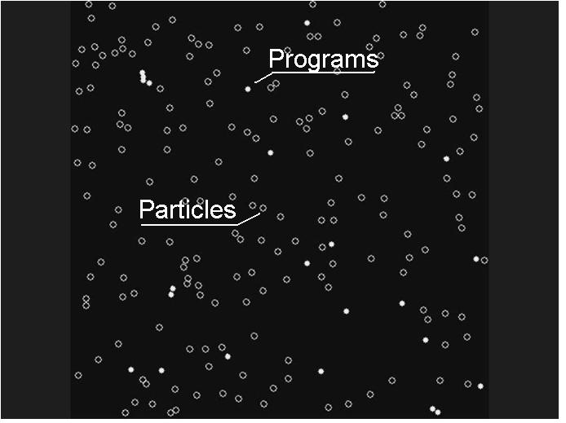
Example of simulation

Slide 40
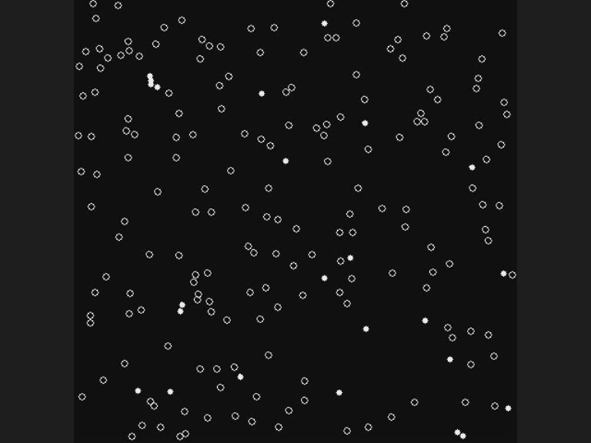
Example of simulation

Slide 41
Sample simulation: Snowflake

Slide 42
Snowflake

Slide 43
Snowflake
Set of 6 programs:
  P1: Builds a seed
  P2: Builds a ring
  P3: Closes the ring
  P4: Starts building a stretching arm
  P5: Builds the arm (started by P4 or P6)
  P6: Starts building a lateral arm

Slide 44
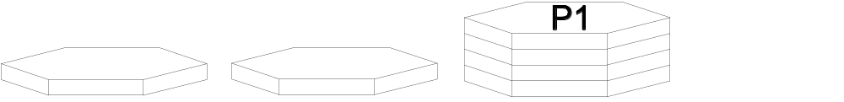
Snowflake – P1 (seed)

Slide 45
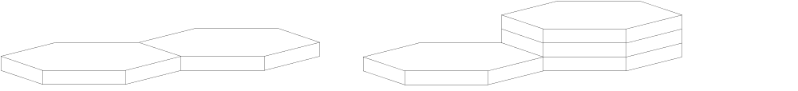
Snowflake – P1(seed)

Slide 46
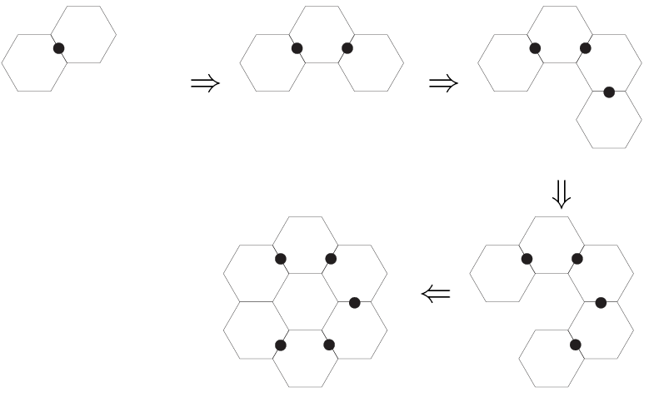
Snowflake – P2 (ring)

Slide 47
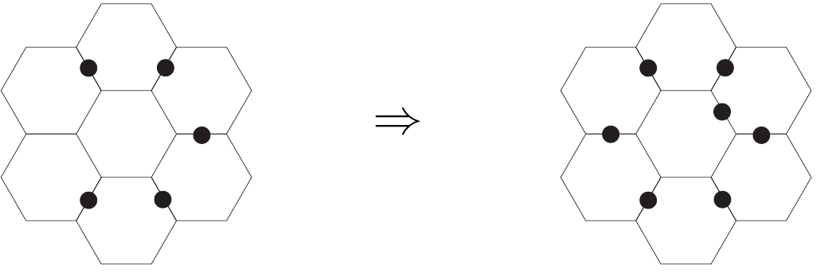
Snowflake – P3 (closed ring)

Slide 48
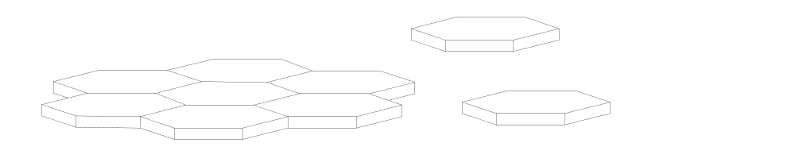
Snowflake – P4 (streching arm)

Slide 49
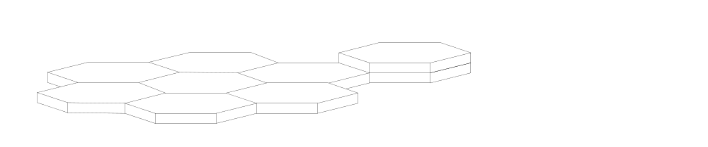
Snowflake – P4 (streching arm)

Slide 50
Snowflake – P5 (building arm)

Slide 51
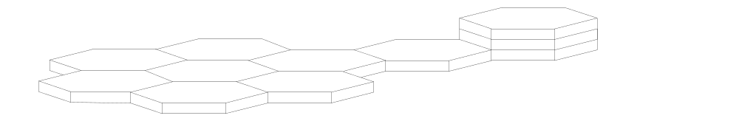
Snowflake – P5 (building arm)

Slide 52
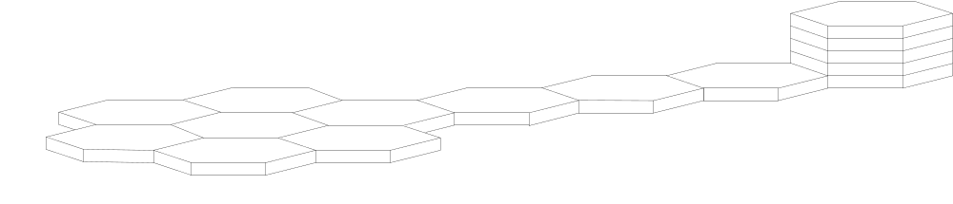
Snowflake – P6 (lateral arm)

Slide 53
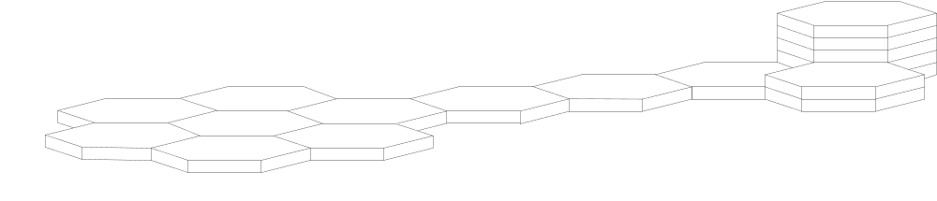
Snowflake – P6 (lateral arm)

Slide 54
The universal constructor

Slide 55
Von Neumann’s model
  A universal constructor A
    A + φ(X) ⇒ A + φ(X) + X

Slide 56
Von Neumann’s model
  A universal constructor A
    A + φ(X) ⇒ A + φ(X) + X
    A + φ(A) ⇒ A + φ(A) + A

Slide 57
Von Neumann’s model
  A universal constructor A
    A + φ(X) ⇒ A + φ(X) + X
    A + φ(A) ⇒ A + φ(A) + A
  A general copying machine B
    B + φ(X) ⇒ B + φ(X) + φ(X)

Slide 58
Von Neumann’s model
  A universal constructor A
    A + φ(X) ⇒ A + φ(X) + X
    A + φ(A) ⇒ A + φ(A) + A
  A general copying machine B
    B + φ(X) ⇒ B + φ(X) + φ(X)
  A control machine C
    A + B + C + φ(A + B + C) ⇒ A + B + C + φ(A + B + C) + A + B + C

Slide 59
Von Neumann’s model
  A universal constructor A
    A + φ(X) ⇒ A + φ(X) + X
    A + φ(A) ⇒ A + φ(A) + A
  A general copying machine B
    B + φ(X) ⇒ B + φ(X) + φ(X)
  A control machine C
    A + B + C + φ(A + B + C) ⇒ A + B + C + φ(A + B + C) + A + B + C
  Additional automaton D
    A + B + C + D + φ(A + B + C + D)
    ⇒ A + B + C + D + φ(A + B + C + D) + A + B + C + D

Slide 60
The universal constructor
Constructs various (but not any possible) structures based on its description from an information string (stack of particles)
Consistent set of programs being able to:
  Find a valid information string in the nearest space
  Connect itself into the string and start the translation
  Sequentially process the string, building the desired structure (described in the information string)

Slide 61
The universal constructor
Works as an interpreter of simple language, with the following instructions (contained in the information string):
  PUT: adds specified particle to the stack,
  SPLIT: splits the currently built stack into two horizontally connected stacks of particles
  NEW: begins construction of a new complex, without disconnecting the constructor from the currently processed information string,
  END: disconnects the universal constructor from the information string, and stops the translation

Slide 62
Constructor program example
PUT(01010101)
PUT(01010101)
SPLIT(NE)
PUT(01010101)
END

Slide 63
Constructor program example
PUT(01010101)
PUT(01010101)
SPLIT(NE)
PUT(01010101)
END

Slide 64
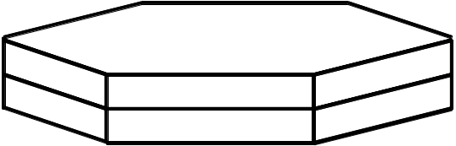
Constructor program example
PUT(01010101)
PUT(01010101)
SPLIT(NE)
PUT(01010101)
END

Slide 65
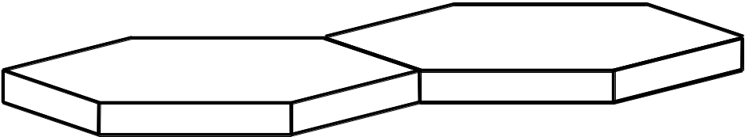
Constructor program example
PUT(01010101)
PUT(01010101)
SPLIT(NE)
PUT(01010101)
END

Slide 66
Constructor program example
PUT(01010101)
PUT(01010101)
SPLIT(NE)
PUT(01010101)
END

Slide 67
Constructor program example
PUT(01010101)
PUT(01010101)
SPLIT(NE)
PUT(01010101)
END

Slide 68
Structure of the information string
END | XXXXXXXX
…
Direction | XXXXXXXX
SPLIT header | XXXXXX11
…
Particle type | XXXXXXXX
NEW header | 11111101
…
Particle type | XXXXXXXX
PUT header | XXXXXX01

Slide 69
String example
END | XXXXXXXX
…
Direction | XXXXXXXX
SPLIT header | XXXXXX11
…
Particle type | XXXXXXXX
NEW header | 11111101
…
Particle type | XXXXXXXX
PUT header | XXXXXX01
11111111
01010101
00000001
00000010
00000011
01010101
00000001
01010101
00000001

Slide 70
String example
END | XXXXXXXX
…
Direction | XXXXXXXX
SPLIT header | XXXXXX11
…
Particle type | XXXXXXXX
NEW header | 11111101
…
Particle type | XXXXXXXX
PUT header | XXXXXX01
11111111
01010101
00000001
00000010
00000011
01010101
00000001
01010101
00000001
PUT(01010101)

Slide 71
String example
END | XXXXXXXX
…
Direction | XXXXXXXX
SPLIT header | XXXXXX11
…
Particle type | XXXXXXXX
NEW header | 11111101
…
Particle type | XXXXXXXX
PUT header | XXXXXX01
11111111
01010101
00000001
00000010
00000011
01010101
00000001
01010101
00000001
PUT(01010101)
PUT(01010101)

Slide 72
String example
END | XXXXXXXX
…
Direction | XXXXXXXX
SPLIT header | XXXXXX11
…
Particle type | XXXXXXXX
NEW header | 11111101
…
Particle type | XXXXXXXX
PUT header | XXXXXX01
11111111
01010101
00000001
00000010
00000011
01010101
00000001
01010101
00000001
PUT(01010101)
PUT(01010101)
SPLIT(NE)

Slide 73
String example
END | XXXXXXXX
…
Direction | XXXXXXXX
SPLIT header | XXXXXX11
…
Particle type | XXXXXXXX
NEW header | 11111101
…
Particle type | XXXXXXXX
PUT header | XXXXXX01
11111111
01010101
00000001
00000010
00000011
01010101
00000001
01010101
00000001
PUT(01010101)
PUT(01010101)
SPLIT(NE)
PUT(01010101)

Slide 74
String example
END | XXXXXXXX
…
Direction | XXXXXXXX
SPLIT header | XXXXXX11
…
Particle type | XXXXXXXX
NEW header | 11111101
…
Particle type | XXXXXXXX
PUT header | XXXXXX01
11111111
01010101
00000001
00000010
00000011
01010101
00000001
01010101
00000001
PUT(01010101)
PUT(01010101)
SPLIT(NE)
PUT(01010101)
END

Slide 75
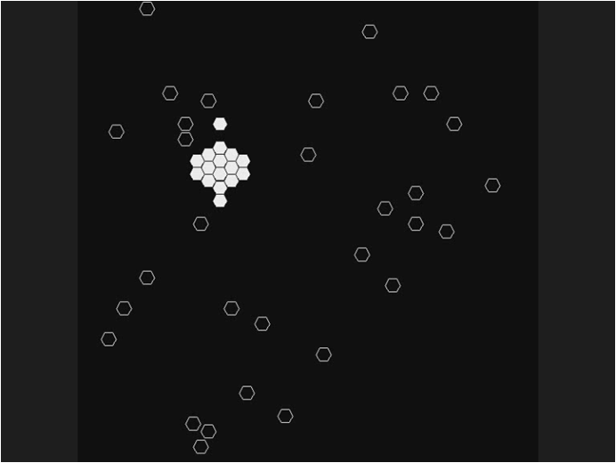
Simulation example
Information string
Universal constructor
Particles

Slide 76
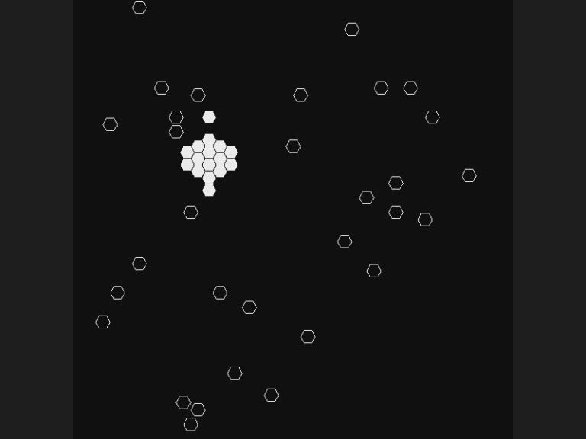
Simulation example

Slide 77
Limitations

Slide 78
Achieving the full universality
Strategy 1
Strategy 2

Slide 79
Snowflake – strategy 1
The shape of the ”snowflake”
cannot be built
by the constructor
The shape can be obtained as a result of activity of a set of 6 building programs
The set of building programs can be build by the constructor

Slide 80
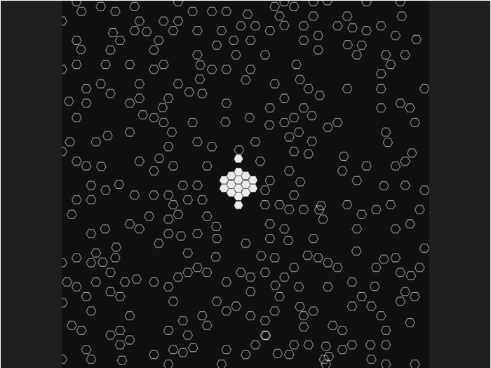
Snowflake – strategy 1
Information string
Universal constructor

Slide 81
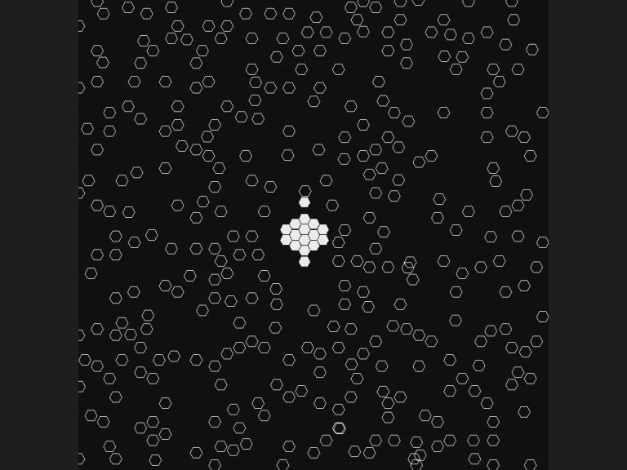
Snowflake – strategy 1

Slide 82
Constructor duplication – strategy 2
It is impossible to encode the constructor’s structure of bonds
The structure being built should not manifest any activity before it is completely finished
The universal constructor should not recognize the structure being built as a part of itself
The best approach is to use the second strategy

Slide 83
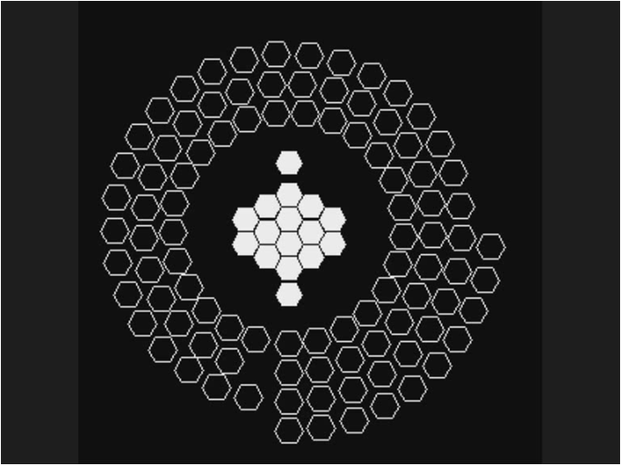
Constructor duplication – strategy 2
Information string
Universal constructor

Slide 84
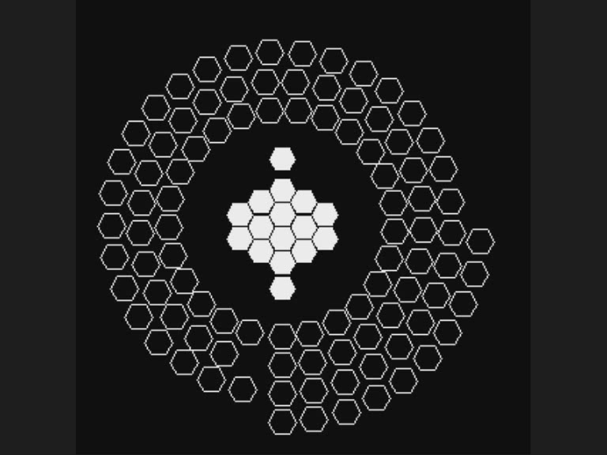
Constructor duplication – strategy 2

Slide 85
Further research…

Slide 86
Further research
Acceleration of execution
Full self-reproduction
Comparing various strategies of self-reproduction
Allowing random changes (physics, programs, …)
…

